Slide 1
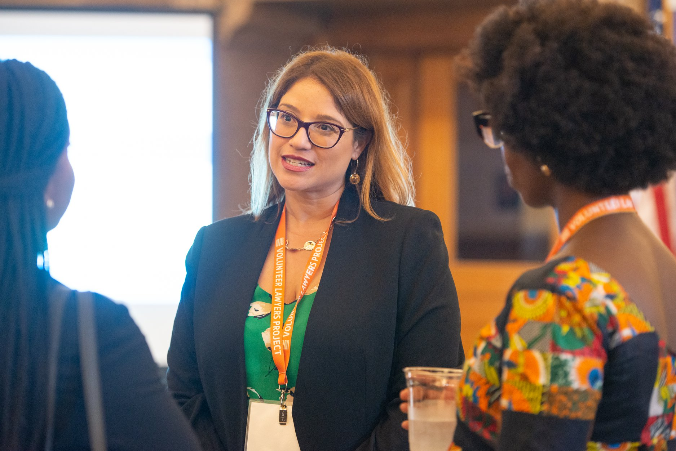
Please introduce yourself in the chat and answer the following question:
What interests you most about
volunteering with VLP?

Slide 2
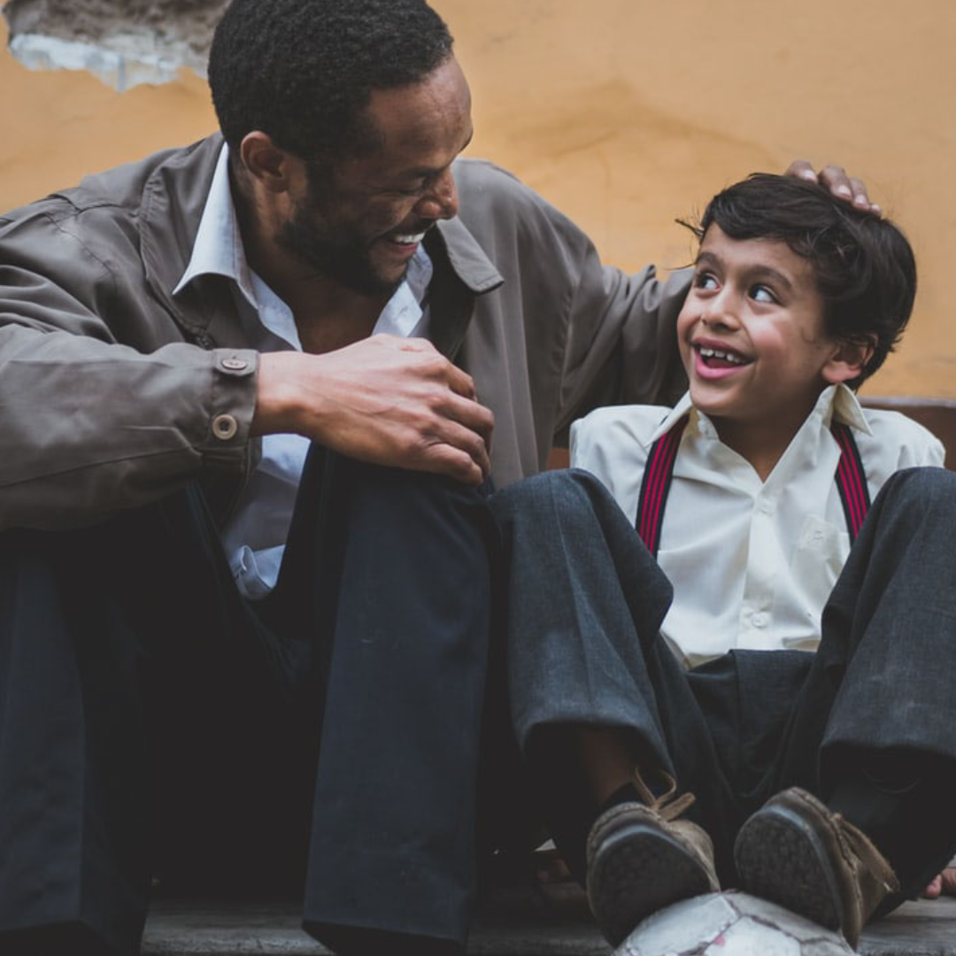
Volunteer Lawyers Project
New Volunteer Orientation
Geraldine Gruvis-Pizzaro
Supervising Staff Attorney
ggruvis-pisarro@vlpnet.org
Emelia Andres
Pro Bono Manager
eandres@vlpnet.org
Danelia Ramirez Aguilar
Pro Bono Assistant
daguilar@vlpnet.org

Slide 3
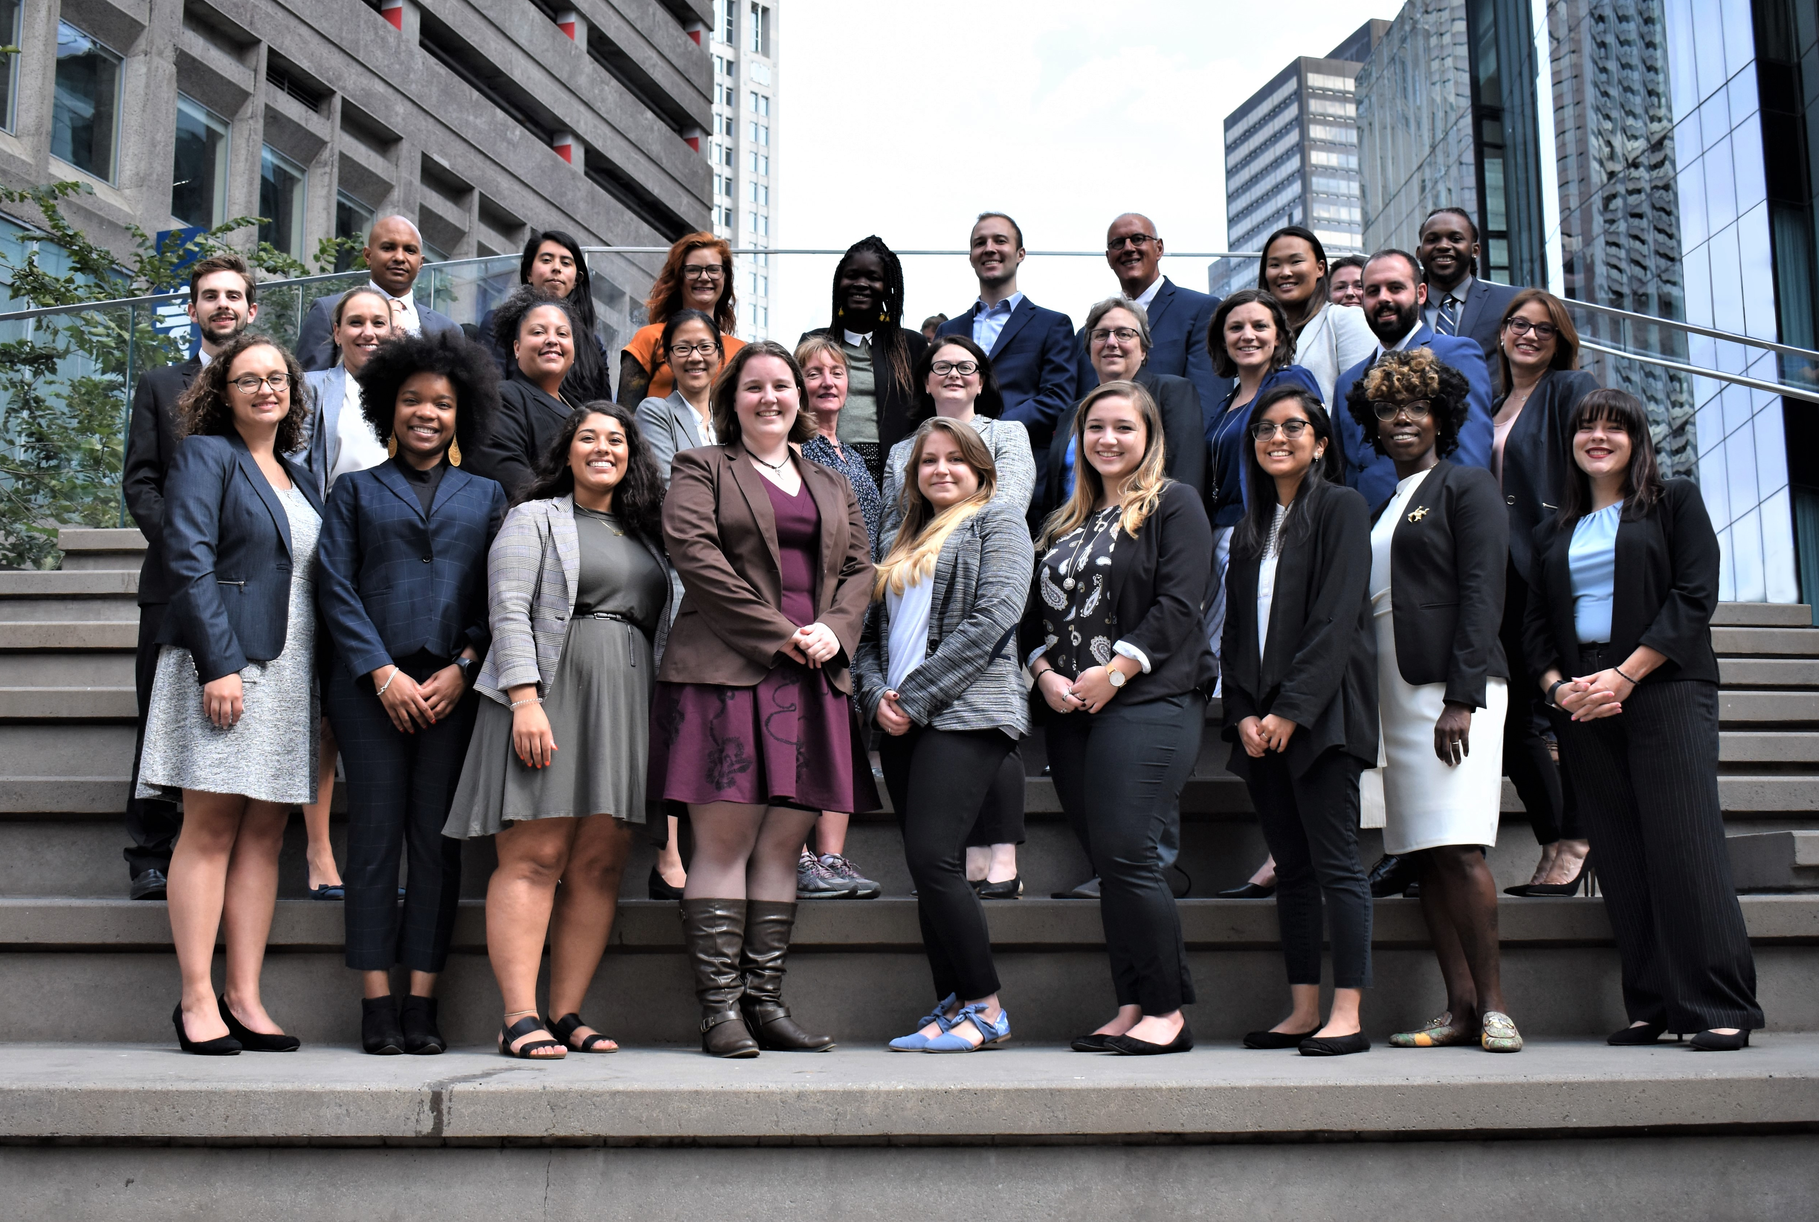
Who is VLP?

Slide 4
Giving Justice a Voice
Small staff
Civil cases
Focus on recruiting, training, and mentoring the private bar
Mentorship, support, and guidance

Slide 5
Who We Serve
All VLP clients must meet 3 criteria:
Low Income
Based on income and assets
Screened for eligibility
Meet VLP’s case priorities

Slide 6
VLP Legal Units
Housing: tenant/landlord including: eviction, affirmative conditions, home ownership preservation, post-foreclosure eviction
Family: divorce, paternity, child support, custody, abuse prevention orders
Probate: guardianship, wills, health care proxies, powers of attorney.
Consumer: debt collection defense; affirmative debt collection claims; credit reporting issues
Bankruptcy: Chapter 7 bankruptcies
Employment: unemployment, wage & hour

Slide 7
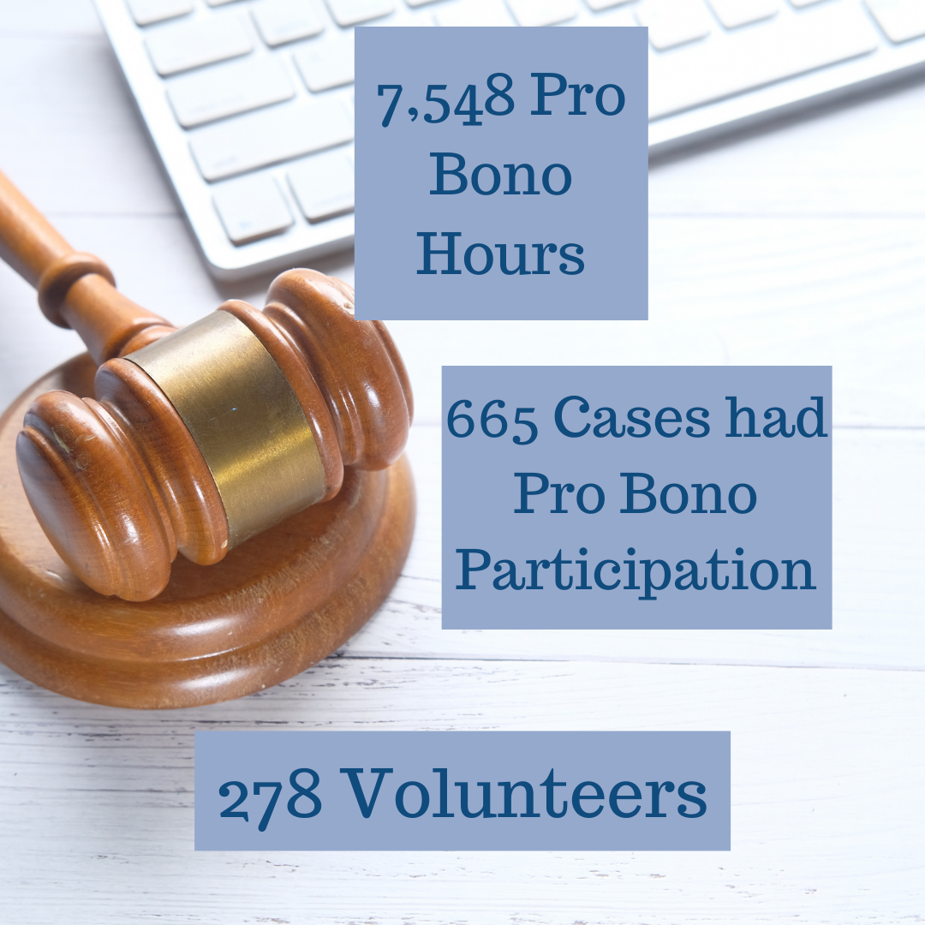
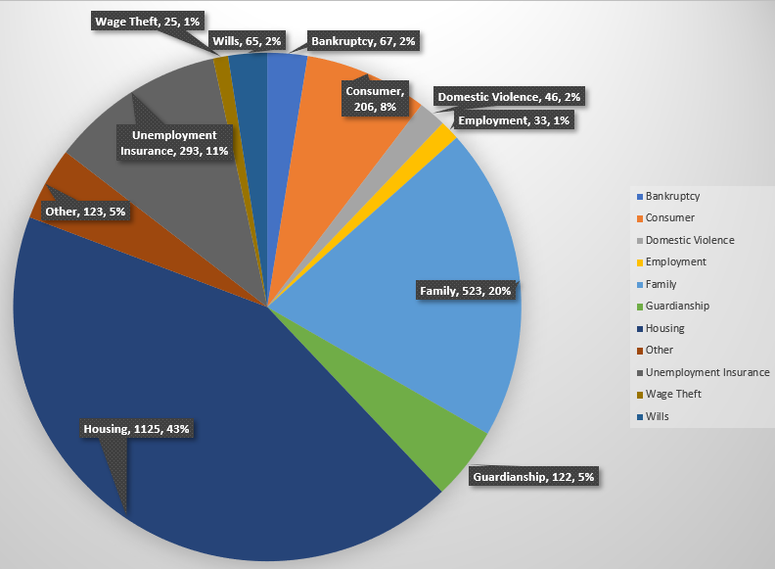
VLP Stats for 2021

Slide 8
What is Limited Assistance Representation?

Slide 9
Limited Assistance Representation
Limited Assistance Representation (LAR) allows an attorney to represent a client for a brief period on a specific issue. VLP clinics are LAR opportunities.
To become certified to provide limited assistance representation, you must review the LAR handbook. You can also watch the training video.
LAR registration is effective upon reviewing the training materials.
You do not need to review the materials to fill out paperwork or answer questions. You MUST be LAR certified to represent a client in court under LAR guidelines.

Slide 10
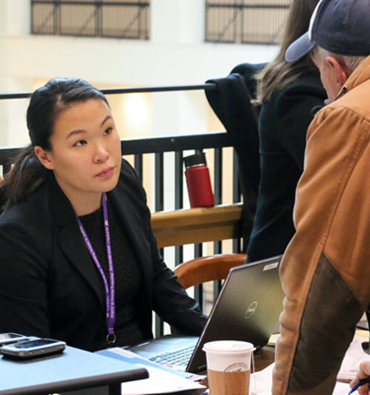
How LAR Works at VLP
For Documents:
Stamp paperwork “Prepared with the Assistance of Counsel” as required by LAR guidelines
For Hearings:
File a Notice of Appearance and Notice of Withdrawal after work is completed

Slide 11
Volunteer Opportunities

Slide 12
Advice Panels
A quick, no strings attached volunteer opportunity. You can volunteer from anywhere! Attorneys help clients on a Limited Assistance basis.
How it Works:
Legal Areas
VLP screens clients who could use more advice.
Don’t fit in any legal aid organization’s priorities but would benefit from advice
Attorneys sign up for specific legal areas.
The attorney selects their desired amount of time to give advice.
VLP sends the attorney the client’s information and a brief summary of the issues.
The attorney calls during their set time and provides advice.
Housing
Family
Employment
Wills & Trusts

Slide 13
Clinics
VLP holds weekly clinics in a range of legal areas. Most clinics are held in a courthouse. Some clinics are for drafting documents only, and some clinics aid clients with hearings the same day. Attorneys represent clients on a Limited Assistance basis.
Virtual Family Law and Guardianship Clinic
Volunteers provide help to clients facing a variety of Family Law issues or Guardianship needs. These clinics focus on drafting and advice.
Location and Times:
Every 1st and 3rd Wednesday from 9am-2pm at Suffolk Probate and Family
Court (CSC office space for scheduled/limited walk-in clients)
Every 2nd and 4th Wednesday on VLP’s Zoom Account (scheduled clients)
Every 2nd and 4th Thursday at Middlesex Probate and Family Court in
Woburn for Guardianship clinics (Walk in clinic)
How It Works:
VLP screens clients before the clinic day.
Volunteers sign up on the Family Law or Guardianship pages on VLP’s website.
We send you the Zoom information.
At the clinic, meet with your client in a breakout room.
VLP staff is available to meet with you in your breakout room or separately.

Slide 14
Clinics
Eastern Housing Court Lawyer for the Day
Volunteers assist pro se tenants with their eviction cases/affirmative cases against their landlords.
Location and Time: EVERY TUESDAY!
IN-PERSON from 9:00am-12:00pm at Eastern Housing Court
Edward W. Brooke Court House, 24 New Chardon St., Boston, MA 02114
ON ZOOM mornings from 9:00am-12:00pm
afternoons from 1:00pm-4:00pm
How It Works:
VLP has an online sign-up sheet where volunteers can select a morning or afternoon 3-hour shift. Reminder that the morning shift has both virtual and in-person opportunities available!
VLP staff will conduct a quick intake and screen clients for eligibility.
VLP staff attorneys are always present to mentor, supervise, and assist volunteers while they provide assistance to pro se litigants.
Types of assistance offered: advice, drafting, mediation, representation in court.
Volunteers can work alone, in pairs, or shadow VLP staff attorneys.

Slide 15
Clinics
Housing Answer and Discovery Clinic
Volunteers assist pro se tenants with completing their Answer and Discovery documents.
The Answer is the tenant's opportunity to respond to their landlord's reasons for eviction. It is where tenants can assert defenses to the eviction, counterclaims they may have against their landlord, and most importantly, they can request a jury trial.
The Discovery request allows tenants to receive information and documents that will help them fight their eviction case in court. It will also help tenants prepare their defenses to eviction and counterclaims against their landlord.
Location and Time: EVERY THURSDAY on Zoom
We host the clinic at 9am and 11am
It will take approximately two (2) hours to complete the Answer and Discovery documents
How It Works:
Volunteers will work with pro se tenants facing eviction and will help them complete their Answer and Discovery documents using an online tool
Once the documents are complete, a VLP staff attorney will review the tenant's documents and will file them with the court and will serve a copy on the tenant's landlord or their landlord's attorney.

Slide 16
Clinics
Consumer Lawyer for the Day
Volunteers assist defendants in their small claim debt collection cases and represent the client in their hearing.
Location and Time:
1st and 3rd Thursdays (BMC Central); 2nd and 4th Thursdays (BMC Dorchester) of the month 11am session and 2pm session over Zoom
1st and 3rd Wednesdays of the month (BMC Central – civil)
Additional cases available for LAR or full representation aside from the above clinic sessions
How It Works:
VLP staff attend the court session on Zoom.
Potential clients approach VLP for legal assistance. The potential client's case gets continued.
VLP’s paralegal assigns a client to an available volunteer with the case details.
Volunteers and clients schedule a time to meet virtually and work on settlement options or prepare for trial.

Slide 17
Remote and In-Person Clinic Expectations
Preparation
Ensure that you are on-time and ready to support VLP's Clients
Communicate with paralegal or staff attorney if you are running late or need to leave clinic early
Dress Code (Even while volunteering Remotely)
Do's: Formal Business Dress Attire, Dress Shirts, Ties, Blouses, Blazers, Suit Jackets,
Don'ts: Casual Attire: T-Shirts, Sweatshirts, leggings, yoga pants, hats
First time Volunteers
In some legal areas it is important to shadow the first couple times you volunteer to get the hang of it before taking a client on your own. You can do that by indicating or selecting "Shadow only" on the clinic signup sheets
Confidentiality
Use Headphones
Private space
Ensure your camera is turned on and you have a clean zoom background free of distraction

Slide 18
Projects
This project are hosted with other organizations. It have specific required trainings.
Civil Appeals Clinic
Volunteers meet with clients to discuss final judgements and discuss appellate issues and procedures. This clinic works on a rotating basis with volunteers only attending every 7-8 weeks. This clinic is run in partnership with Boston-based members of the Association of Pro Bono Counsel. Volunteers must review the training materials before attending.
Locations and Time:
Wednesdays, 12pm-4pm on VLP’s Zoom Account

Slide 19
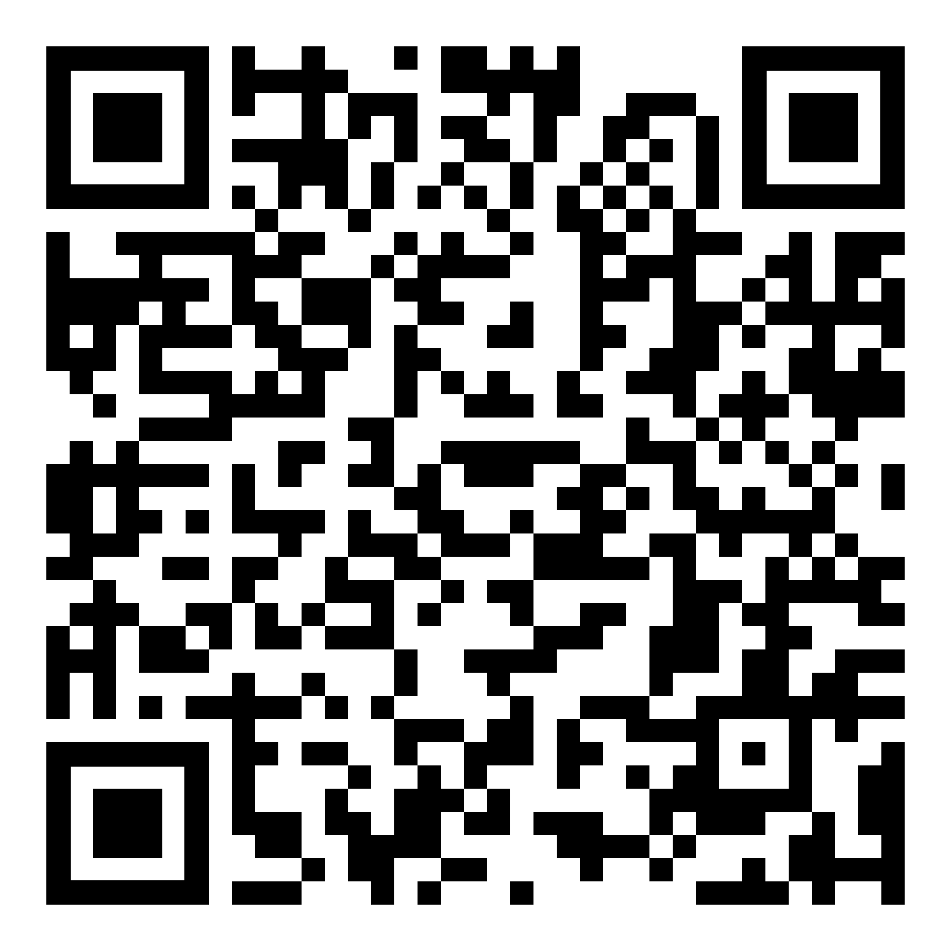
Projects
Landlord Advocacy
The VLP Landlord Advocacy Program is a team of lawyers, law students, paralegals and members of the legal community working together to advocate for the low-income "mom and pop" landlords who live in and rent out part of their multi-family homes. The Landlord Advocacy team's goal is to provide upstream assistance to low-income landlords of 2-3 family properties. In addition to programs serving those who are in court or considering court, the Landlord team strives to address the broader issues our landlord population faces. The landlord volunteer programs and services were developed to find, educate, and advise small landlords on their rights and responsibilities and provide assistance and resources when applicable. All programs are 100% virtual-based and volunteering activities are 100% remote. Training and staff support will be provided.
Locations and Time:
Flexible; Scan the QR code to sign up. Our landlord team will be in touch shortly.

Slide 20
Full Rep Cases
Some of our cases reach the level of needing a pro bono attorney to represent the client.
How to Take a Case
Pro Bono Manager sends out the cases to the appropriate panel every Wednesday.
If you are interested, you request the case.
If the case is still available, the Pro Bono Manager will assign the case to you:
Legal Server access
Interpreter
Mentor
Need to Knows
You will have access to the referral memo, pertinent case documents, and a three-party retainer in Legal Server.
You MUST complete the three-party retainer.
You will handle the case as your own with guidance and legal support from VLP staff.
You should keep us updated on the status of the case.
Emailed status updates from VLP paralegal
Other communication as needed or desired

Slide 21
Questions?

Slide 22
What VLP Provides
Mentorship & Support
Meeting Space
Interpreters
Free Trainings
MCLE Vouchers
Lunches & Events
Malpractice Insurance

Slide 23
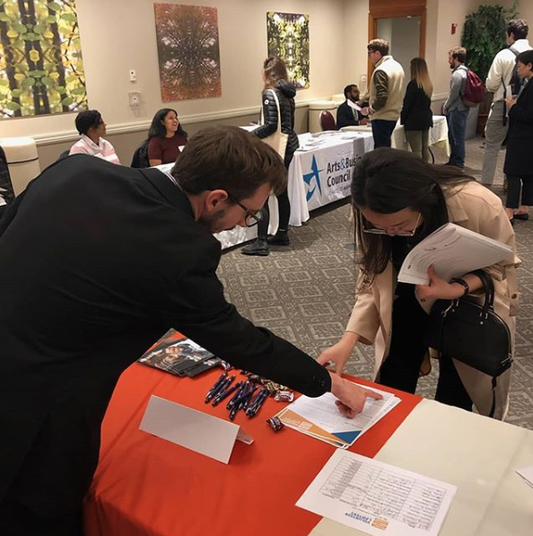
Upcoming Trainings
VLP now has all trainings available online! Links can be sent to you for any training you’re interested in.

Slide 24
Working with Interpreters

Slide 25
Read or Listen as I Read Aloud
Black bears are not true hibernators. Hibernation is not the same for them as it is for rodents, such as jumping mice or woodchucks, whose body temperatures drop significantly during hibernation, and whose hearts will beat only 4x per minute. The body temperature of a black bear drops only a few degrees below normal while their metabolic rate is cut in half. They awaken quickly if danger threatens, and will occasionally emerge from their dens during warm winter spells.

Slide 26
What did the last slide say?
?
?
?
?
?
?
?
?

Slide 27
Working with Interpreters
Do’s
Don'ts
Speak in a normal tone.
Speak directly to the client. Eye contact is important.
Speak slowly if you are using complex legal terms or specific dates/numbers/etc.
Allow the interpreter to clarify questions for a client or explain a word in a different way if their native language does not have a word for it.
Use the interpreter for all conversations with the client.
Don’t talk louder. The interpreter understands you and talking louder will not make the client understand better.
Don’t talk to the interpreter only. The client is still the focus.
Don’t tell the interpreter to explain something to the client for you. If you need a term, document, etc. explained, you should explain it as you would to an English speaking or hearing client.
Don’t let the client and interpreter speak back and forth too long without clarifying what is happening. Make sure the interpreter is not giving legal advice.
Don’t try to speak with the client yourself if you are not fluent in their language.

Slide 28
Working with Low Income Clients

Slide 29
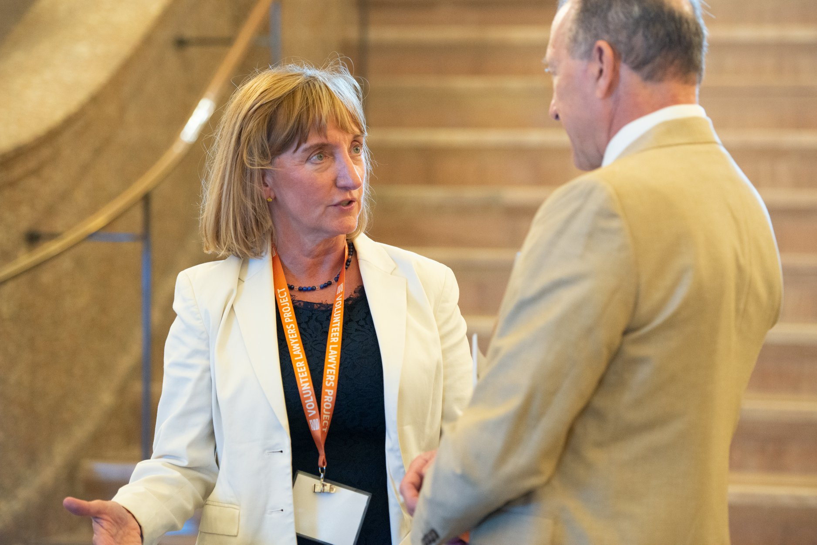
Communication
The world, especially court, requires formal communication.
Formal register is required to succeed in the world.
Use for job interviews, meeting new people, asking for help, and talking to a person of authority.
Required for court.
People in poverty speak in a casual register.
Friendly tone usually used with friends.
Comes across as rude or improper in formal situations.

Slide 30
Their lives and priorities may look different than yours.
Clients can have difficulty keeping appointments.
Child Care
Demanding Work Schedules
Transportation Issues
They can be difficult to reach.
Housing isn’t always stable
Phones run out of minutes
Internet may not always work
May forget to return your calls because other, more pressing issues come up
You may have to be flexible.
Schedule appointments around their work hours
Think about if they will have to bring their children with them
Find a place that is easy to get to if transportation is a concern
What to do if you lose touch with your client:
Call VLP so we can reach out to the client
Try sending a letter or email

Slide 31
Considerations in the Current Climate
Try to maintain quality communication
Phone calls and video chats will help you form a better relationship with your client than email
BUT access to the internet, computers, and smart phones are a luxury
Client may have lost access to their ability to review, scan, and print documents
New legal issues may arise as a result of the pandemic
You should direct clients to reach out to us with new legal issues
You should only help with the legal issue outlined in the LAR or 3-party agreement

Slide 32
What impact Does VLP have?

Slide 33
“This was a wonderful experience for a very kind and grateful client.”
“VLP always does a great job assembling the raw data from the client and makes our job so much easier (saves us hours!).”
“Rewarding. I'd do it again.”
“My mentors were very helpful in answering all my questions promptly and clearly. While preparing for the uncontested hearing, I felt comfortable asking any question I had.”
“I got excellent support from both lawyers - draft briefs, advice, coaching. It was a pleasure to work on this case and to see the client work out her housing problem and get settled in a new place.”
“It was a great experience and did not require that much of a time commitment. I will be being taking another case again next year.”
What Our Volunteers Say

Slide 34
“I would have not gotten to the process by myself. With VLP help, I felt more confident when standing in front of the judge. I would totally recommend them. I am, and always will be, forever grateful with them.”
-Guardianship Client
“With the legal help I received, I was able to collect a multiple of my unpaid wages. My lawyer and his team were amazing. I could not ask for better legal representation…They were easily accessible and would respond to all inquiries immediately. Tremendous job and help!”
-Wage Theft Client
“The fact of knowing that I can count on your help in moments of financial struggle is like a blessing for me.”
-Divorce Client
What Our Clients Say
“Major relief knowing that once I pass my children will be left with something and that I took the proper step to secure my assets and leave them with something.”
-Will Client
“[I realized] I wasn't the only person this ever happened to. And there was a light at the end of the tunnel.”
-Bankruptcy Client

Slide 35
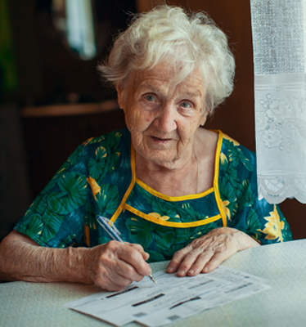
What’s Next?
You will receive a follow up email this week
It will have a link to a survey
Contact information
Area of law you are interested in
If you are interested in:
Taking a case
Volunteering at a clinic
Providing advice
Questions? Contact Emelia Andres Pro Bono Manager eandres@vlpnet.org

Slide 36
Questions?

